Slide 1
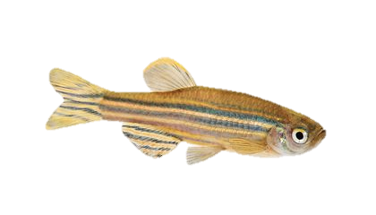

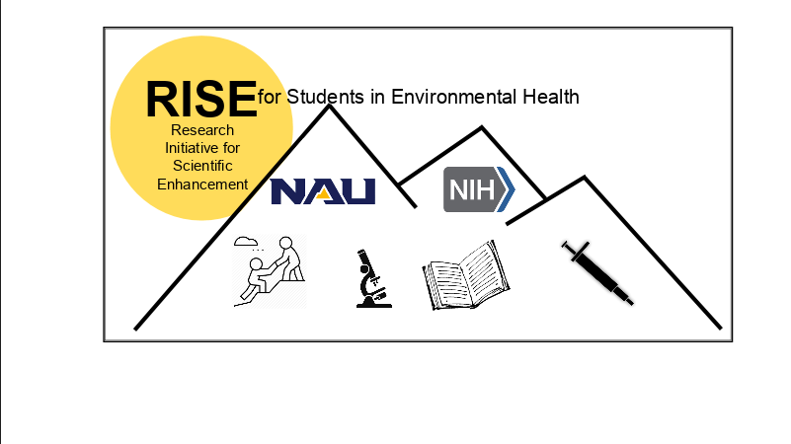

Impacts on Development from Uranium and Arsenic exposure in zebrafish (Danio Rerio)
Oscar Lujan
Salanga Lab – Northern Arizona University
Grant number: R25GM127199-02

Slide 2
What is Arsenic (As)?
Naturally occurring element found in the earth’s crust.
Sources of exposure: air (coal burning), water (wells), and food (pesticides).
Common use of As: wood preservative (green color), pesticides, and chemotherapy drug (Trisenox).
Elemental arsenic with molecular information.
Image: https://periodictable.com/Elements/033/index.html
Notes:
-Reference for bullet two: https://www.ncbi.nlm.nih.gov/pmc/articles/PMC1519547/pdf/envhper00384-0242.pdf

Slide 3
Arsenic Induced Pathologies
Induction of cancers: skin, bladder, and liver.
Skin impacts: As keratosis, cancer, and hyperpigmentation.
As intake limits: EPA MCL for water 10 μg/L, OSHA air limit of 10 µg/m³, FDA 100 ppb infant rice cereal.
Water limit is equal to five teaspoons of arsenic in 660,000 gallons of water (Olympic pool).
Extreme case of As keratosis in Bangladesh.
Image: https://link.springer.com/article/10.1007/s00244-018-0511-4

Slide 4
What is Uranium (U)?
U is a naturally occurring element found in the earth’s crust.
Sources of exposure: air (burning ammunition), water (wells), and soil (mining operations).
Common use of U: fuel for nuclear reactors and special ammunition for the military.
Elemental uranium with molecular information.
Image: https://theodoregray.com/periodictable/Samples/092.19/index.s12.html
Notes:
-Reference for bullet two: https://www.mdpi.com/2305-6304/2/1/50/pdf

Slide 5
Uranium Induced Pathologies
Respiratory impacts: fibrosis and emphysema.
Renal impacts: tubule degeneration, proteinuria, and renal failure.
U intake limit: EPA MCL for water is 30 μg/L, OSHA air limit 0.05 mg/m³ uranium, FDA has no regulation on food.
Water limit is equal to 15 teaspoons of uranium in 660,000 gallons of water (Olympic pool).
Pathologies caused by uranium’s chemical and radiological properties.
Image: https://www.epa.gov/navajo-nation-uranium-cleanup/health-effects-uranium
Notes:
-Mention uranium miners on the reservation

Slide 6
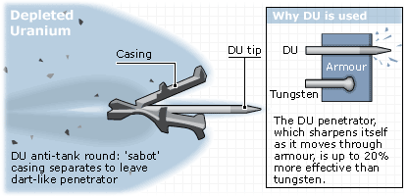
Depleted Uranium (DU)
Natural U is made up of three different isotopes: U-234, U-235, and U-238.
Nuclear reactors use the U-235 isotope as the main source of fuel, but natural U only contains 0.7% of U-235.
Engineers increase the content of U-235 through a process known as enrichment. This procedure leaves behind U that is depleted of its U-235 isotope (DU).
DU is used by the military to produce anti-tank ammunition.
Image: http://news.bbc.co.uk/2/hi/in_depth/2860759.stm

Slide 7
Water Access on the Navajo Nation
As or U tainted well water is common for many rural communities, especially here in the Northern Arizona region.
The Native American population who live on the reservation have limited accessibility to clean water, leading to health disparities from As/U well water exposure.
Local Navajo Nation member Darlene Arviso drives multiple hours each day to deliver fresh water.
Image: https://www.azcentral.com/story/news/local/arizona-environment/2017/09/03/native-american-tribes-fight-clean-water-and-more-money/617172001/
Notes:
-Reference for bullet one: https://www.who.int/news-room/fact-sheets/detail/drinking-water
-Reference for bullet two: https://www.ncbi.nlm.nih.gov/pmc/articles/PMC5425493/
-Reference for bullet three: https://newsmaven.io/indiancountrytoday/archive/water-hole-no-running-water-on-navajo-nation-reservation-JF3R11tCVkeLkYHSz2BxMQ/

Slide 8
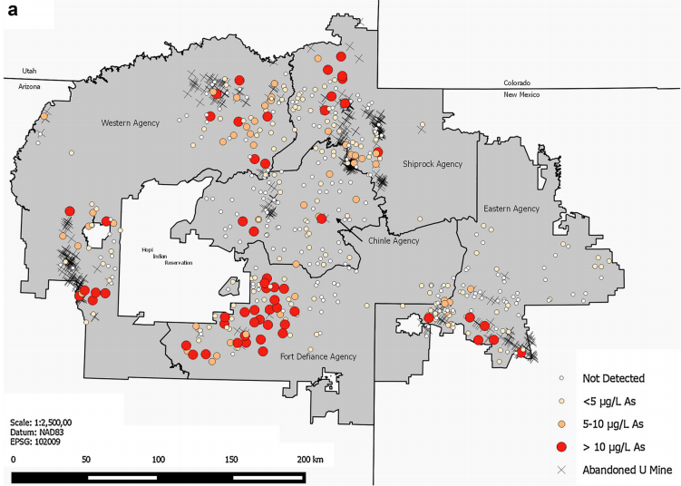
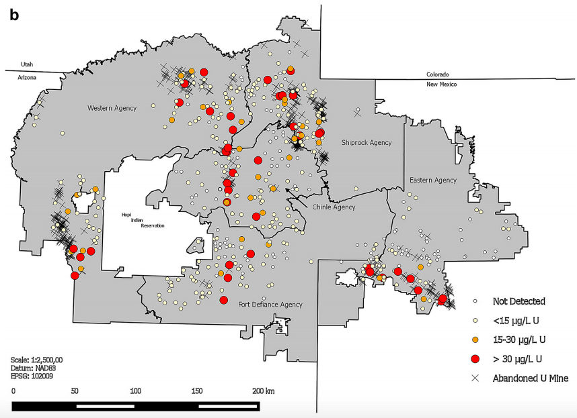
Interrelationship of As and U on the Navajo Nation
As Levels in Unregulated Water sources
U Levels in Unregulated Water sources
Image: https://www.ncbi.nlm.nih.gov/pmc/articles/PMC5425493/
Notes:
-Hopi reservation is also experiencing As/U water issues, but there is less monitoring that is publicly available. As water mitigation plan is being implemented.
-People are at risk for dual exposure as demonstrated by the two figures.

Slide 9
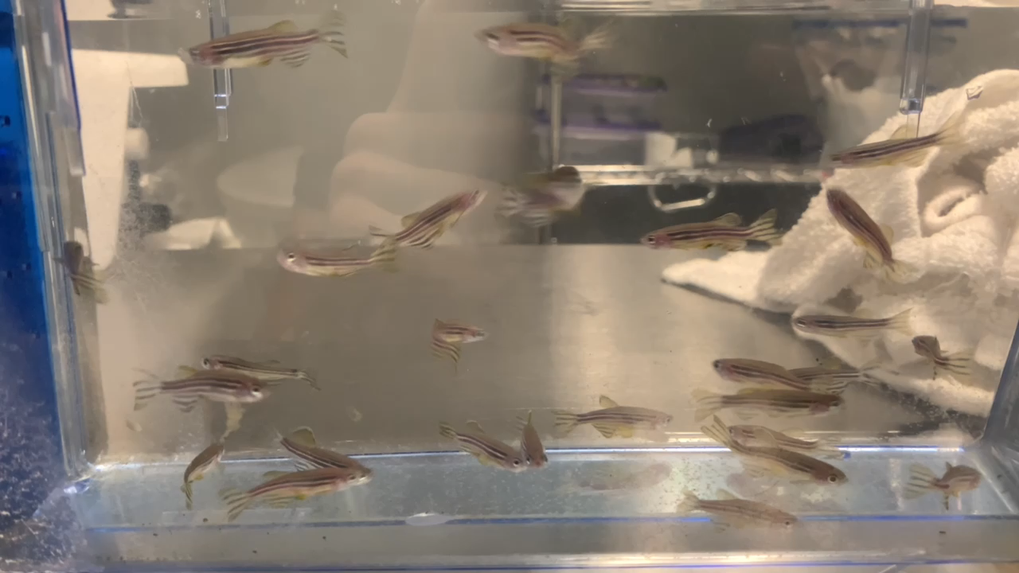
Why zebrafish?
Genome is roughly 70% similar to humans and 82% of disease associated genes in humans have a zebrafish ortholog.
Share important structures such as a cardiovascular system, central nervous system, and digestive tract
Rapid development and straight forward genetics.
Transparent membrane allows for easy microscopy.
Cheaper than mice and more complex than cells in culture
Notes:
-Orthologs are genes in different species that evolved from a common ancestral gene by speciation, and, in general, retain the same function during the course of evolution.
-Paralogs are homologous genes that have evolved by duplication and code for protein with similar, but not identical functions.
-Homologs are genes that derive from the same ancestral sequence
-Reference for bullet one: https://news.psu.edu/story/418819/2016/07/28/research/zebrafish-help-researchers-study-human-genes
-Reference for bullet two and three: http://www.uoneuro.uoregon.edu/k12/FAQs.html
-Behavior/Development are endpoints sensitive and simplistic to pollutants and thus allow us to measure an immediate cause and effect.

Slide 10
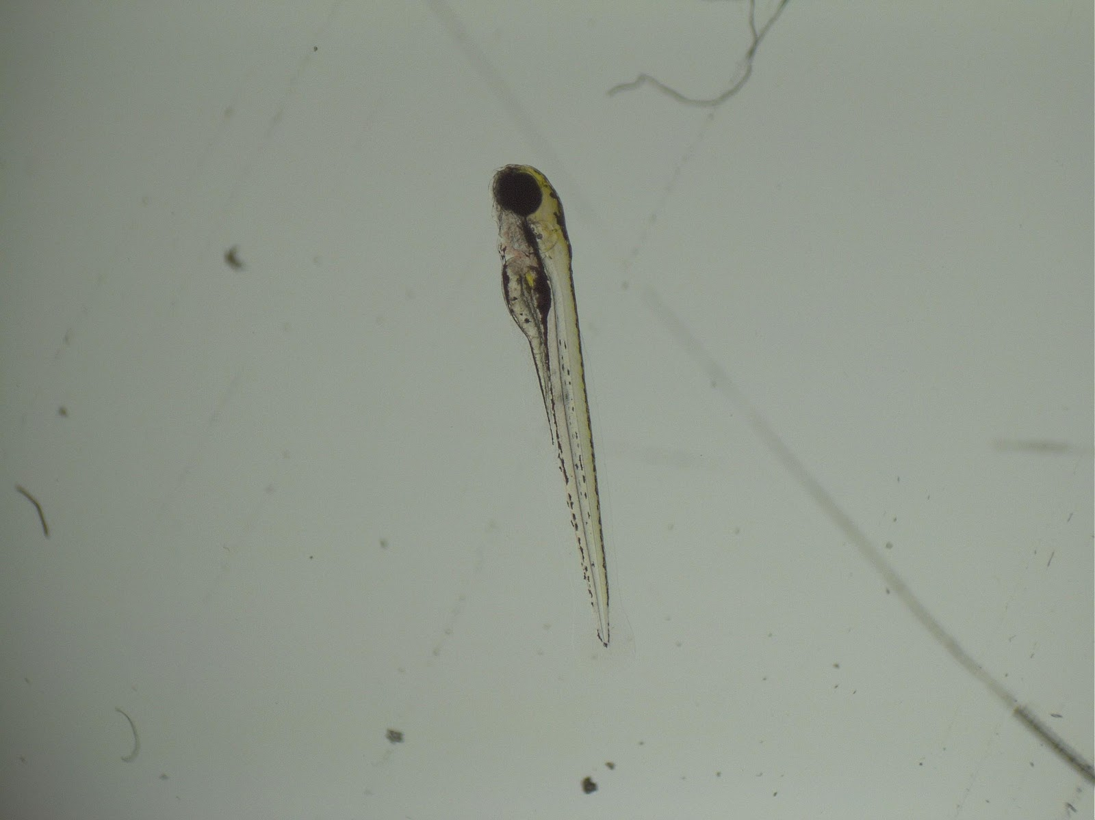
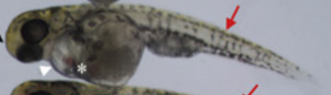
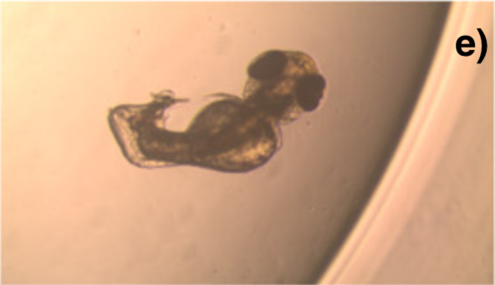
Knowledge Gap
No Exposure
Li et al. (2009) and Olivares et al. (2016) assessed the developmental impacts of As exposure in zebrafish. Significant abnormalities in development occurred at 500 uM and higher exposure.
Lourenço et al. (2017) investigated the impacts of treated U mine water and solid uranium sludge on zebrafish development. Results demonstrated teratogenic effects in both U treatments.
Literature contains information on the developmental impacts of As & U exposure individually, but not in combination.
As Exposure
U Exposure
Image: http://zebrafishlab.be/photos/zebrafish-embryos-and-larvae
Image: https://www.sciencedirect.com/science/article/abs/pii/S0166445X08003792
Image: https://www.sciencedirect.com/science/article/abs/pii/S0048969717315292?via%3Dihub

Slide 11
Hypothesis
Combined exposure to As and U will induce synergistically negative health impacts

Slide 12
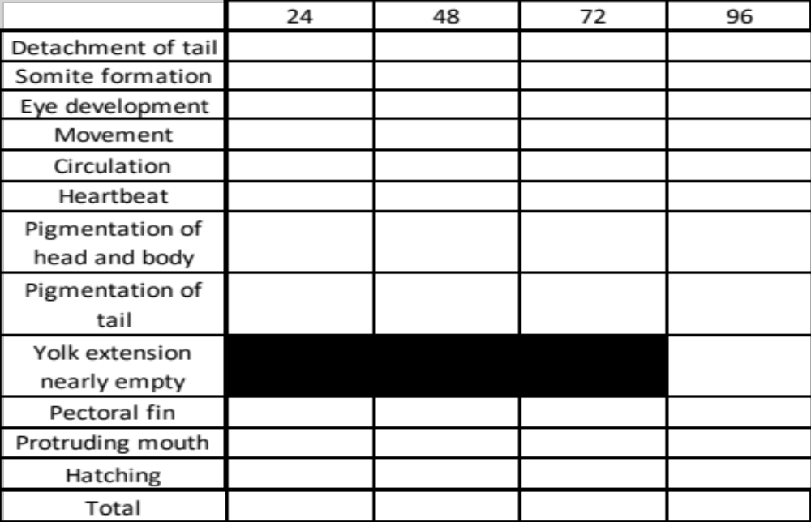
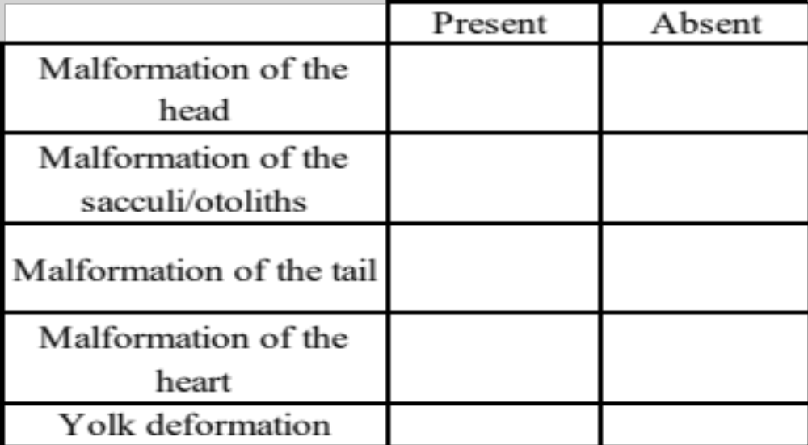
The Fish Embryo Toxicity Test (FET)
The FET is an observational assay that reviews four endpoints used to determine lethality and toxicity: coagulation of embryos, lack of somite formation, non-detachment of the tail, and lack of heartbeat.
The General Morphology Scoring (GMS) system is a point-based assay paired with the FET to give a more comprehensive assessment of development. Morphological traits are evaluated over the course of 96 hours with points given each day for all structures.

Slide 13
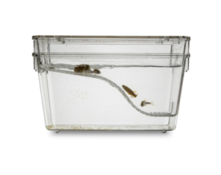
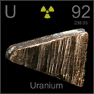
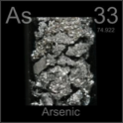
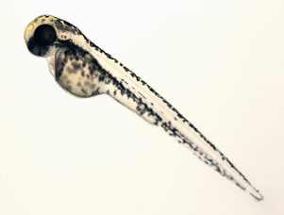
Developmental Study Method
Eye formation
Pigmentation of the body
Heart formation
Yolk sac formation
Notes:
-Abnormal development is the expected outcome.

Slide 14
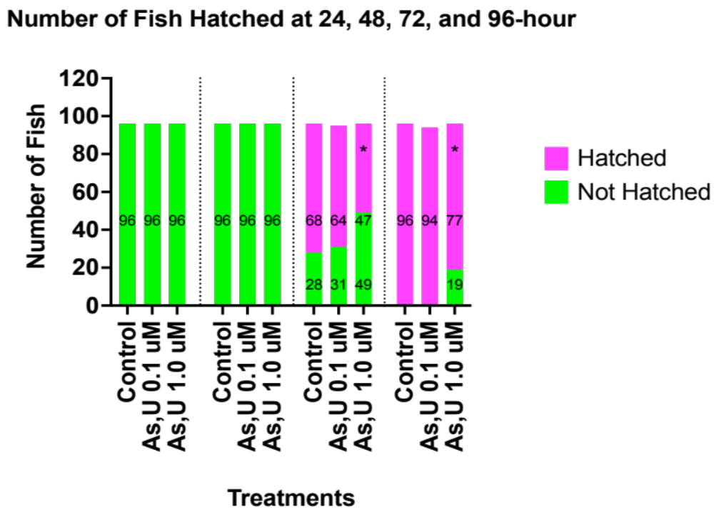
Results: Delay in Hatching in Mixture Group

Slide 15
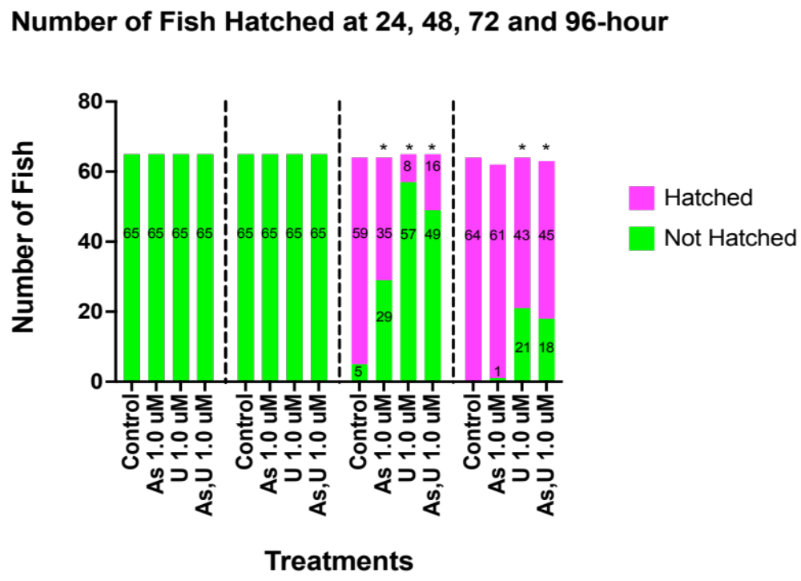
Results: Delay in Hatching in Mixture Group

Slide 16
Implications
This study is the first step in determining how exposure to both elements can impact development.
Results from this study will shed light on an issue that has been impacting people silently for the past century.
Image: https://unitus.vc/updates/creative-business-solutions-to-indias-drinking-water-problems/
Notes:
Implications are good for both human and wildlife impacts. Possible impairment in human development and wildlife outcome may be hurt by pollutants.

Slide 17
Thank You SWS for the Opportunity to Share My Research!

Slide 18
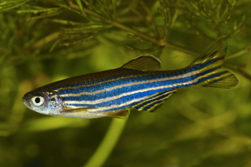
QUESTIONS?

